Slide 1
Chapter 8 – Software Testing
CS 425 October 29, 2024
Ian Sommerville,
Software Engineering, 10th Edition
Pearson Education, Addison-Wesley
Note: These are a slightly modified version of Chapter 8 slides available from the author’s site http://iansommerville.com/software-engineering-book/
Chapter 8 Software Testing

Slide 2
Topics covered
Development testing
Test-driven development
Release testing
User testing
Chapter 8 Software Testing

Slide 3
Program testing
Testing is intended to show that a program does what it is intended to do and to discover program defects before it is put into use.
When you test software, you execute a program using artificial data.
You check the results of the test run for errors, anomalies or information about the program’s non-functional attributes.
Can reveal the presence of errors NOT their absence.
Testing is part of a more general verification and validation process, which also includes static validation techniques.
Chapter 8 Software Testing
Notes:
Anomalies or errors should be documented so they can be fixed or resolved

Slide 4
Validation and defect testing
The first goal leads to validation testing
To demonstrate to the developer and the customer that the software meets its requirements.
You expect the system to perform correctly using a given set of test cases that reflect the system’s expected use.
A successful test shows that the system operates as intended.
The second goal leads to defect testing
To discover situations in which the behavior of the software is incorrect, undesirable or does not conform to its specification.
The test cases are designed to expose defects.
A successful test is a test that makes the system perform incorrectly and so exposes a defect in the system.
Chapter 8 Software Testing
Notes:
Validate requirements find defects
The test cases in defect testing can be deliberately obscure and need not reflect how the system is normally used.

Slide 5
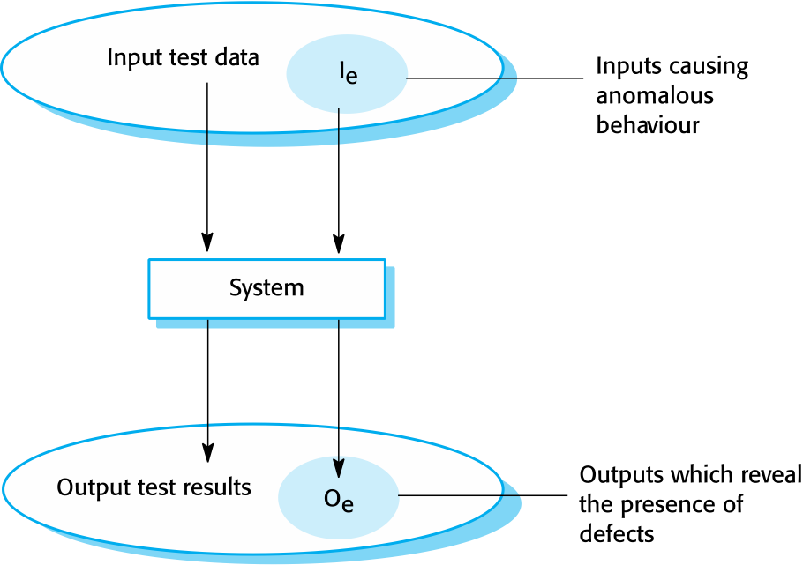
An input-output model of program testing
Chapter 8 Software Testing

Slide 6
Verification vs validation
Verification: "Are we building the product right”.
The software should conform to its specification.
Validation: "Are we building the right product”.
The software should do what the user really requires.
Chapter 8 Software Testing
Notes:
Aim of V & V is to establish confidence that the system is ‘fit for purpose’.
Depends on system’s purpose, user expectations and marketing environment
Software purpose
The level of confidence depends on how critical the software is to an organisation.
User expectations
Users may have low expectations of certain kinds of software.
Marketing environment
Getting a product to market early may be more important than finding defects in the program.

Slide 7
Software inspections
These involve people examining the source representation with the aim of discovering anomalies and defects.
Inspections not require execution of a system so may be used before implementation.
They may be applied to any representation of the system (requirements, design,configuration data, test data, etc.).
They have been shown to be an effective technique for discovering program errors.
Chapter 8 Software Testing

Slide 8
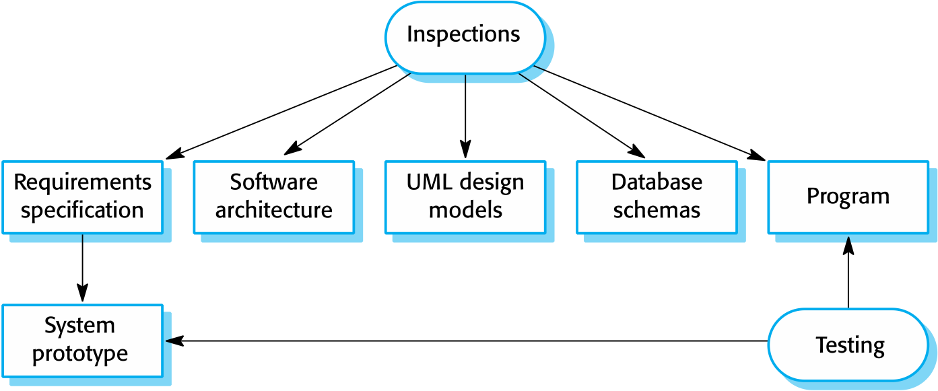
Inspections and testing
Chapter 8 Software Testing

Slide 9
Advantages of inspections
During testing, errors can mask (hide) other errors. Because inspection is a static process, you don’t have to be concerned with interactions between errors.
Incomplete versions of a system can be inspected without additional costs. If a program is incomplete, then you need to develop specialized test harnesses to test the parts that are available.
As well as searching for program defects, an inspection can also consider broader quality attributes of a program, such as compliance with standards, portability and maintainability.
Chapter 8 Software Testing

Slide 10
Inspections and testing
Inspections and testing are complementary and not opposing verification techniques.
Both should be used during the V & V process.
Inspections can check conformance with a specification but not conformance with the customer’s real requirements.
Inspections cannot check non-functional characteristics such as performance, usability, etc.
Chapter 8 Software Testing

Slide 11
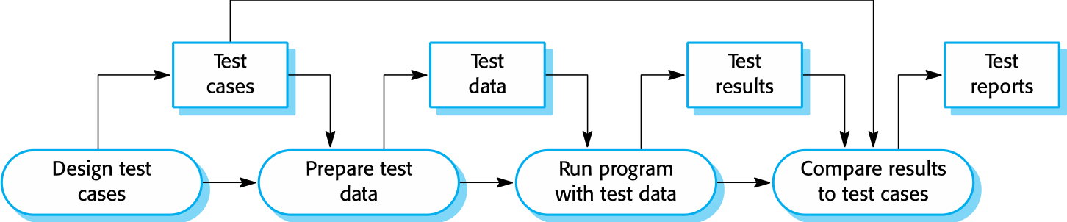
A model of the software testing process
Chapter 8 Software Testing

Slide 12
Stages of testing
Development testing, where the system is tested during development to discover bugs and defects.
Release testing, where a separate testing team test a complete version of the system before it is released to users.
User testing, where users or potential users of a system test the system in their own environment.
Chapter 8 Software Testing

Slide 13
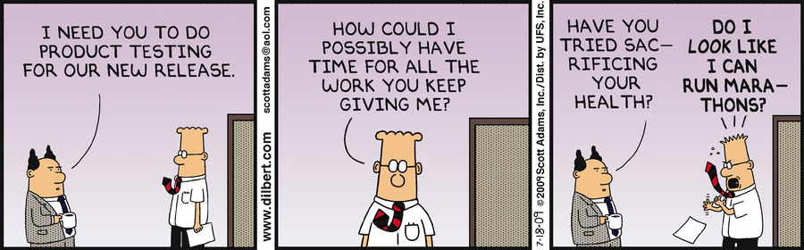
Development testing
Chapter 8 Software Testing

Slide 14
Development testing
Development testing includes all testing activities that are carried out by the team developing the system.
Unit testing, where individual program units or object classes are tested. Unit testing should focus on testing the functionality of objects or methods.
Component testing, where several individual units are integrated to create composite components. Component testing should focus on testing component interfaces.
System testing, where some or all of the components in a system are integrated and the system is tested as a whole. System testing should focus on testing component interactions.
Chapter 8 Software Testing

Slide 15
Unit testing
Unit testing is the process of testing individual components in isolation.
It is a defect testing process.
Units may be:
Individual functions or methods within an object
Object classes with several attributes and methods
Composite components with defined interfaces used to access their functionality.
Chapter 8 Software Testing

Slide 16
Object class testing
Complete test coverage of a class involves
Testing all operations associated with an object
Setting and interrogating all object attributes
Exercising the object in all possible states.
Inheritance makes it more difficult to design object class tests as the information to be tested is not localised.
Chapter 8 Software Testing

Slide 17
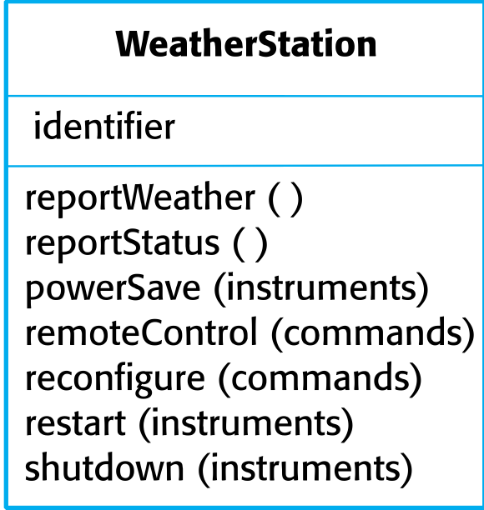
The weather station object interface
For example:
Shutdown -> Running-> Shutdown
Configuring-> Running-> Testing -> Transmitting -> Running
Running-> Collecting-> Running-> Summarizing -> Transmitting -> Running
Chapter 8 Software Testing
Notes:
Need to define test cases for reportWeather, calibrate, test, startup and shutdown.
Using a state model, identify sequences of state transitions to be tested and the event sequences to cause these transitions

Slide 18
Automated testing
Whenever possible, unit testing should be automated so that tests are run and checked without manual intervention.
In automated unit testing, you make use of a test automation framework (such as JUnit) to write and run your program tests.
Unit testing frameworks provide generic test classes that you extend to create specific test cases. They can then run all of the tests that you have implemented and report, often through some GUI, on the success of otherwise of the tests.
Chapter 8 Software Testing

Slide 19
Automated test components
A setup part, where you initialize the system with the test case, namely the inputs and expected outputs.
A call part, where you call the object or method to be tested.
An assertion part where you compare the result of the call with the expected result. If the assertion evaluates to true, the test has been successful if false, then it has failed.
Chapter 8 Software Testing

Slide 20
Choosing unit test cases
The test cases should show that, when used as expected, the component that you are testing does what it is supposed to do.
If there are defects in the component, these should be revealed by test cases.
This leads to 2 types of unit test case:
The first of these should reflect normal operation of a program and should show that the component works as expected.
The other kind of test case should be based on testing experience of where common problems arise. It should use abnormal inputs to check that these are properly processed and do not crash the component.
Chapter 8 Software Testing

Slide 21
Testing strategies
Partition testing, where you identify groups of inputs that have common characteristics and should be processed in the same way.
You should choose tests from within each of these groups.
Guideline-based testing, where you use testing guidelines to choose test cases.
These guidelines reflect previous experience of the kinds of errors that programmers often make when developing components.
Chapter 8 Software Testing

Slide 22
Partition testing
Input data and output results often fall into different classes where all members of a class are related.
Each of these classes is an equivalence partition or domain where the program behaves in an equivalent way for each class member.
Test cases should be chosen from each partition.
Chapter 8 Software Testing

Slide 23
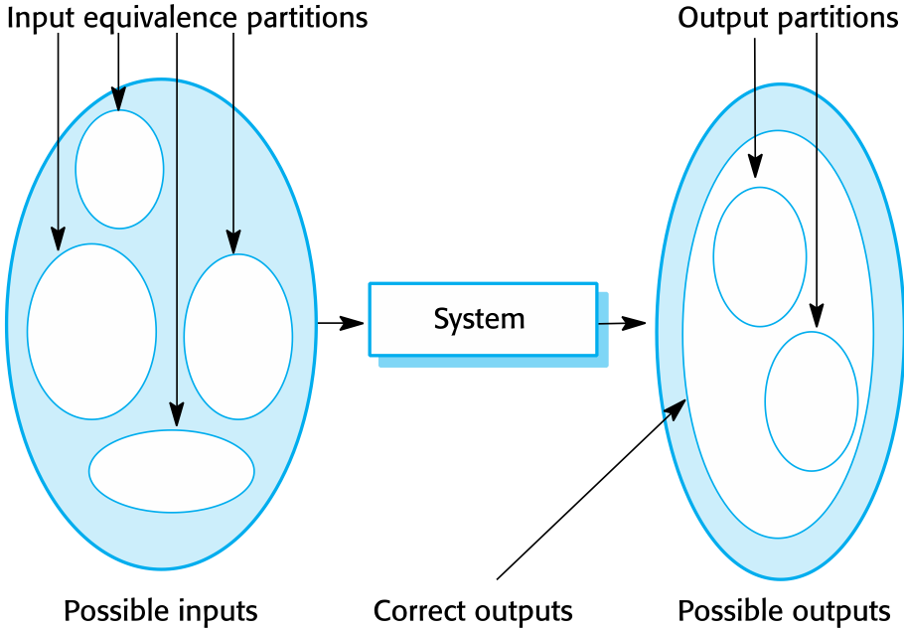
Equivalence partitioning
Chapter 8 Software Testing
Notes:
The large ellipse on the left represents the set of all possible inputs to the program that is being tested. The smaller unshaded ellipses represent the equivalence partitions. A program being tested should process all of the members of an input equivalence partition in the same way. You may need to define a separate input equivalence partition where the only common characteristic of the inputs is that they generate outputs within the same output patrician. The shaded area in the left ellipse represents inputs that are valid. The shaded area in the right ellipse represents exceptions that my occur.
Choose test cases from each partition and a selection of test cases on the boundaries of the partitions.

Slide 24
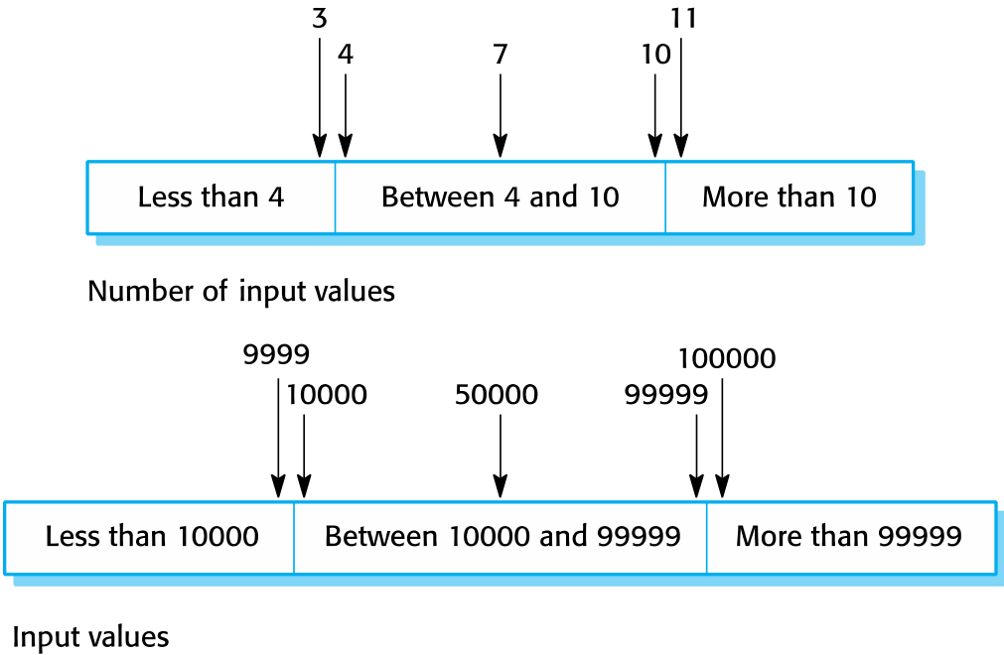
Equivalence partitions
Chapter 8 Software Testing
Notes:
A program specification states that the program accepts four to eight inputs which are five-digit integers greater than 10,000.
When you use the specification of a system to identify equivalence partitions, this is called black-box testing.

Slide 25
Testing guidelines (sequences)
Test software with sequences which have only a single value.
Use sequences of different sizes in different tests.
Derive tests so that the first, middle and last elements of the sequence are accessed.
Test with sequences of zero length.
Chapter 8 Software Testing

Slide 26
General testing guidelines
Choose inputs that force the system to generate all error messages
Design inputs that cause input buffers to overflow
Repeat the same input or series of inputs numerous times
Force invalid outputs to be generated
Force computation results to be too large or too small.
Chapter 8 Software Testing

Slide 27
Component testing
Software components are often composite components that are made up of several interacting objects.
For example, in the weather station system, the reconfiguration component includes objects that deal with each aspect of the reconfiguration.
You access the functionality of these objects through the defined component interface.
Testing composite components should therefore focus on showing that the component interface behaves according to its specification.
You can assume that unit tests on the individual objects within the component have been completed.
Chapter 8 Software Testing

Slide 28
Interface testing
Objectives are to detect faults due to interface errors or invalid assumptions about interfaces.
Interface types
Parameter interfaces Data passed from one method or procedure to another.
Shared memory interfaces Block of memory is shared between procedures or functions.
Procedural interfaces Sub-system encapsulates a set of procedures to be called by other sub-systems.
Message passing interfaces Sub-systems request services from other sub-systems
Chapter 8 Software Testing

Slide 29
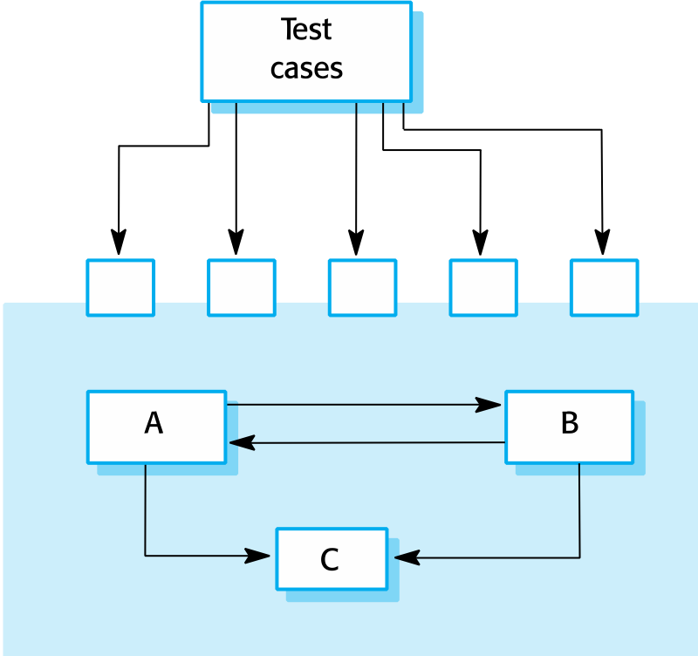
Interface testing
Chapter 8 Software Testing
Notes:
Idea of component interface testing. Assume that components A, B, and C have been integrated to create a larger component or subsystems. The test cases are not applied to the individual components but rather to the interface of the composite component created by combining these components. Interface errors in the composite component may not be detectable by testing the individual objects because these errors result from interactions between the objects in the component.

Slide 30
Interface errors
Interface misuse
A calling component calls another component and makes an error in its use of its interface e.g. parameters in the wrong order.
Interface misunderstanding
A calling component embeds assumptions about the behaviour of the called component which are incorrect.
Timing errors
The called and the calling component operate at different speeds and out-of-date information is accessed.
Chapter 8 Software Testing

Slide 31
Interface testing guidelines
Design tests so that parameters to a called procedure are at the extreme ends of their ranges.
Always test pointer parameters with null pointers.
Design tests which cause the component to fail.
Use stress testing in message passing systems.
In shared memory systems, vary the order in which components are activated.
Chapter 8 Software Testing

Slide 32
System testing
System testing during development involves integrating components to create a version of the system and then testing the integrated system.
The focus in system testing is testing the interactions between components.
System testing checks that components are compatible, interact correctly and transfer the right data at the right time across their interfaces.
System testing tests the emergent behavior of a system.
Chapter 8 Software Testing

Slide 33
System and component testing
During system testing, reusable components that have been separately developed and off-the-shelf systems may be integrated with newly developed components. The complete system is then tested.
Components developed by different team members or sub-teams may be integrated at this stage. System testing is a collective rather than an individual process.
In some companies, system testing may involve a separate testing team with no involvement from designers and programmers.
Chapter 8 Software Testing

Slide 34
Use-case testing
The use-cases developed to identify system interactions can be used as a basis for system testing.
Each use case usually involves several system components so testing the use case forces these interactions to occur.
The sequence diagrams associated with the use case documents the components and interactions that are being tested.
Chapter 8 Software Testing

Slide 35
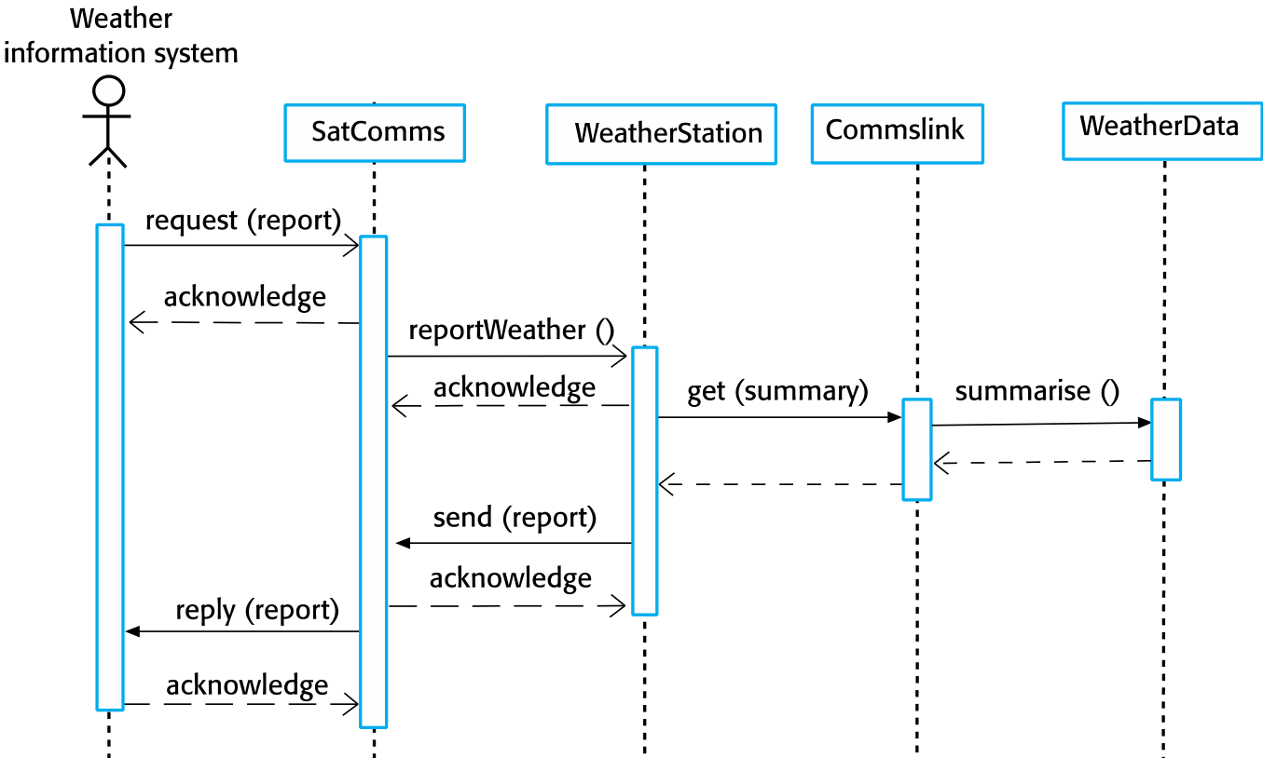
Collect weather data sequence chart
Chapter 8 Software Testing
Notes:
Test cases derived from sequence diagram
An input of a request for a report should have an associated acknowledgement. A report should ultimately be returned from the request.
You should create summarized data that can be used to check that the report is correctly organized.
An input request for a report to WeatherStation results in a summarized report being generated.
Can be tested by creating raw data corresponding to the summary that you have prepared for the test of SatComms and checking that the WeatherStation object correctly produces this summary. This raw data is also used to test the WeatherData object.

Slide 36
Testing policies
Exhaustive system testing is impossible so testing policies which define the required system test coverage may be developed.
Examples of testing policies:
All system functions that are accessed through menus should be tested.
Combinations of functions (e.g. text formatting) that are accessed through the same menu must be tested.
Where user input is provided, all functions must be tested with both correct and incorrect input.
Chapter 8 Software Testing

Slide 37
System Testing
Use Case Testing
Component Testing
Interface Testing
Component Testing
Interface Testing
Component Testing
Interface Testing
Unit Test
Unit Test
Unit Test
Unit Test
Unit Test
Unit Test
Unit Test
Object class testing
Automated testing
Partition Testing
Chapter 8 Software Testing

Slide 38
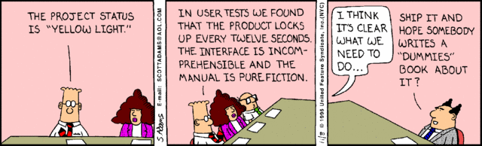
Test-driven development
Chapter 8 Software Testing

Slide 39
Test-driven development
Test-driven development (TDD) is an approach to program development in which you inter-leave testing and code development.
Tests are written before code and ‘passing’ the tests is the critical driver of development.
You develop code incrementally, along with a test for that increment. You don’t move on to the next increment until the code that you have developed passes its test.
TDD was introduced as part of agile methods such as Extreme Programming. However, it can also be used in plan-driven development processes.
Chapter 8 Software Testing

Slide 40
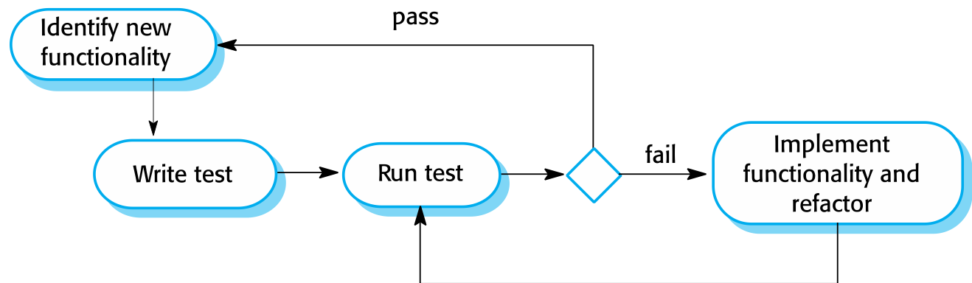
Test-driven development
Chapter 8 Software Testing
Notes:
Test Driven Activities:
Start by identifying the increment of functionality that is required. This should normally be small and implementable in a few lines of code.
Write a test for this functionality and implement this as an automated test.
Run the test, along with all other tests that have been implemented. Initially, you have not implemented the functionality so the new test will fail.
Implement the functionality and re-run the test.
Once all tests run successfully, you move on to implementing the next chunk of functionality.

Slide 41
Benefits of test-driven development
Code coverage
Every code segment that you write has at least one associated test so all code written has at least one test.
Regression testing
A regression test suite is developed incrementally as a program is developed.
Simplified debugging
When a test fails, it should be obvious where the problem lies. The newly written code needs to be checked and modified.
System documentation
The tests themselves are a form of documentation that describe what the code should be doing.
Chapter 8 Software Testing

Slide 42
Regression testing
Regression testing is testing the system to check that changes have not ‘broken’ previously working code.
In a manual testing process, regression testing is expensive but, with automated testing, it is simple and straightforward. All tests are rerun every time a change is made to the program.
Tests must run ‘successfully’ before the change is committed.
Chapter 8 Software Testing

Slide 43
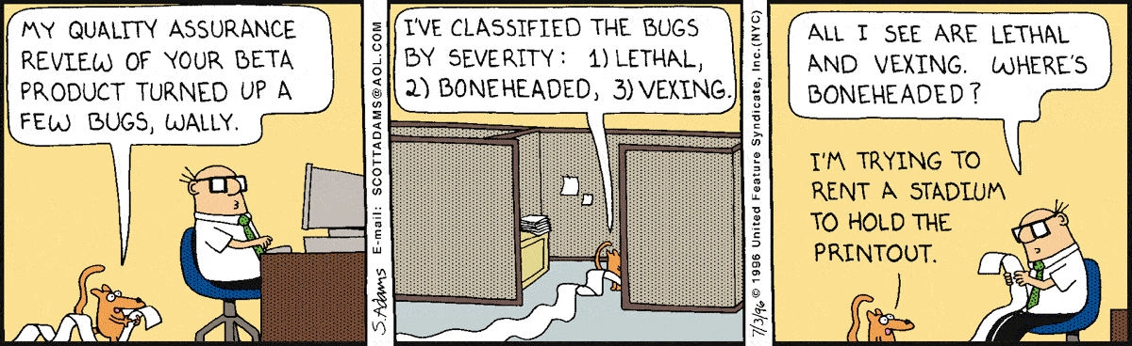
Release testing
Chapter 8 Software Testing

Slide 44
Release testing
Release testing is the process of testing a particular release of a system that is intended for use outside of the development team.
The primary goal of the release testing process is to convince the supplier of the system that it is good enough for use.
Release testing, therefore, has to show that the system delivers its specified functionality, performance and dependability, and that it does not fail during normal use.
Release testing is usually a black-box testing process where tests are only derived from the system specification.
Chapter 8 Software Testing

Slide 45
Release testing and system testing
Release testing is a form of system testing.
Important differences:
A separate team that has not been involved in the system development, should be responsible for release testing.
System testing by the development team should focus on discovering bugs in the system (defect testing). The objective of release testing is to check that the system meets its requirements and is good enough for external use (validation testing).
Chapter 8 Software Testing

Slide 46
Requirements based testing
Requirements-based testing involves examining each requirement and developing a test or tests for it.
Mentcare system requirements:
If a patient is known to be allergic to any particular medication, then prescription of that medication shall result in a warning message being issued to the system user.
If a prescriber chooses to ignore an allergy warning, they shall provide a reason why this has been ignored.
Chapter 8 Software Testing

Slide 47
Requirements tests
Set up a patient record with no known allergies. Prescribe medication for allergies that are known to exist. Check that a warning message is not issued by the system.
Set up a patient record with a known allergy. Prescribe the medication to that the patient is allergic to, and check that the warning is issued by the system.
Set up a patient record in which allergies to two or more drugs are recorded. Prescribe both of these drugs separately and check that the correct warning for each drug is issued.
Prescribe two drugs that the patient is allergic to. Check that two warnings are correctly issued.
Prescribe a drug that issues a warning and overrule that warning. Check that the system requires the user to provide information explaining why the warning was overruled.
Chapter 8 Software Testing

Slide 48
A usage scenario for the Mentcare system
George is a nurse who specializes in mental healthcare. One of his responsibilities is to visit patients at home to check that their treatment is effective and that they are not suffering from medication side effects.
On a day for home visits, George logs into the Mentcare system and uses it to print his schedule of home visits for that day, along with summary information about the patients to be visited. He requests that the records for these patients be downloaded to his laptop. He is prompted for his key phrase to encrypt the records on the laptop.
One of the patients that he visits is Jim, who is being treated with medication for depression. Jim feels that the medication is helping him but believes that it has the side effect of keeping him awake at night. George looks up Jim’s record and is prompted for his key phrase to decrypt the record. He checks the drug prescribed and queries its side effects. Sleeplessness is a known side effect so he notes the problem in Jim’s record and suggests that he visits the clinic to have his medication changed. Jim agrees so George enters a prompt to call him when he gets back to the clinic to make an appointment with a physician. George ends the consultation and the system re-encrypts Jim’s record.
After, finishing his consultations, George returns to the clinic and uploads the records of patients visited to the database. The system generates a call list for George of those patients who He has to contact for follow-up information and make clinic appointments.
Chapter 8 Software Testing

Slide 49
Features tested by scenario
Authentication by logging on to the system.
Downloading and uploading of specified patient records to a laptop.
Home visit scheduling.
Encryption and decryption of patient records on a mobile device.
Record retrieval and modification.
Links with the drugs database that maintains side-effect information.
The system for call prompting.
Chapter 8 Software Testing
Notes:
Write Tests basted on requirements
Usage Scenario
Identify the features tested by the scenario

Slide 50
Performance testing
Part of release testing may involve testing the emergent properties of a system, such as performance and reliability.
Tests should reflect the profile of use of the system.
Performance tests usually involve planning a series of tests where the load is steadily increased until the system performance becomes unacceptable.
Stress testing is a form of performance testing where the system is deliberately overloaded to test its failure behavior.
Chapter 8 Software Testing

Slide 51
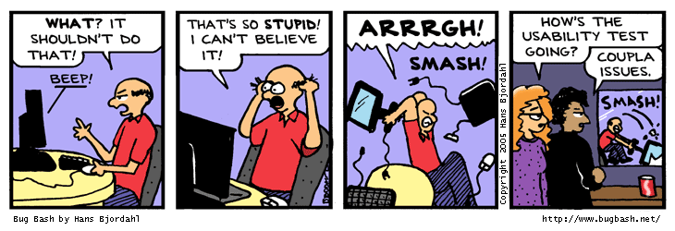
User testing
Chapter 8 Software Testing

Slide 52
User testing
User or customer testing is a stage in the testing process in which users or customers provide input and advice on system testing.
User testing is essential, even when comprehensive system and release testing have been carried out.
The reason for this is that influences from the user’s working environment have a major effect on the reliability, performance, usability and robustness of a system. These cannot be replicated in a testing environment.
Chapter 8 Software Testing

Slide 53
Types of user testing
Alpha testing
Users of the software work with the development team to test the software at the developer’s site.
Beta testing
A release of the software is made available to users to allow them to experiment and to raise problems that they discover with the system developers.
Acceptance testing
Customers test a system to decide whether or not it is ready to be accepted from the system developers and deployed in the customer environment. Primarily for custom systems.
Chapter 8 Software Testing

Slide 54
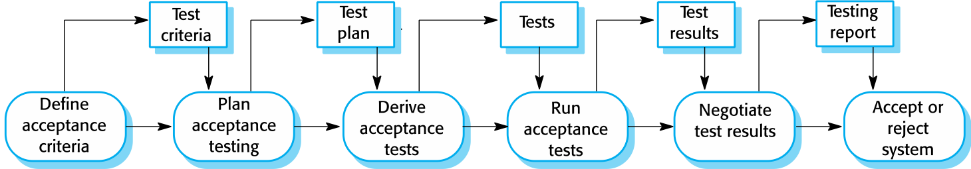
The acceptance testing process
Chapter 8 Software Testing
Notes:
Stages in the acceptance testing process:
Define acceptance criteria
Plan acceptance testing
Derive acceptance tests
Run acceptance tests
Negotiate test results
Reject/accept system

Slide 55
Agile methods and acceptance testing
In agile methods, the user/customer is part of the development team and is responsible for making decisions on the acceptability of the system.
Tests are defined by the user/customer and are integrated with other tests in that they are run automatically when changes are made.
There is no separate acceptance testing process.
Main problem here is whether or not the embedded user is ‘typical’ and can represent the interests of all system stakeholders.
Chapter 8 Software Testing

Slide 56
Key points
Testing can only show the presence of errors in a program. It cannot demonstrate that there are no remaining faults.
Development testing is the responsibility of the software development team. A separate team should be responsible for testing a system before it is released to customers.
Development testing includes unit testing, in which you test individual objects and methods component testing in which you test related groups of objects and system testing, in which you test partial or complete systems.
Chapter 8 Software Testing

Slide 57
Key points
When testing software, you should try to ‘break’ the software by using experience and guidelines to choose types of test case that have been effective in discovering defects in other systems.
Wherever possible, you should write automated tests. The tests are embedded in a program that can be run every time a change is made to a system.
Test-first development is an approach to development where tests are written before the code to be tested.
Scenario testing involves inventing a typical usage scenario and using this to derive test cases.
Acceptance testing is a user testing process where the aim is to decide if the software is good enough to be deployed and used in its operational environment.
Chapter 8 Software Testing

Slide 58
Professional Tip of the Day: Important Email
How to send an important email:
Send it as high priority
If they are on vacation send it the day they get back so it is at the top of their inbox
Put the words “IMPORTANT” or “EMERGENCY” in the email subject line
Follow up with a phone call or Message
Chapter 8 Software Testing

